Slide 1

BANK ANALYTICS REPORT 2021

Slide 2


KEY OBJECTIVES
Primary Objective:
To increase total number of applications
Higher profits
Secondary Objectives:
Enhance workforce efficiency and performance
Achieve measurable improvements in key metrics
Gain data-driven insights into operations and strategies
Optimize the loan portfolio and manage risk
Enhance security and protect against fraud
Improve customer experience and loyalty
Drive business growth and stay competitive

Slide 3
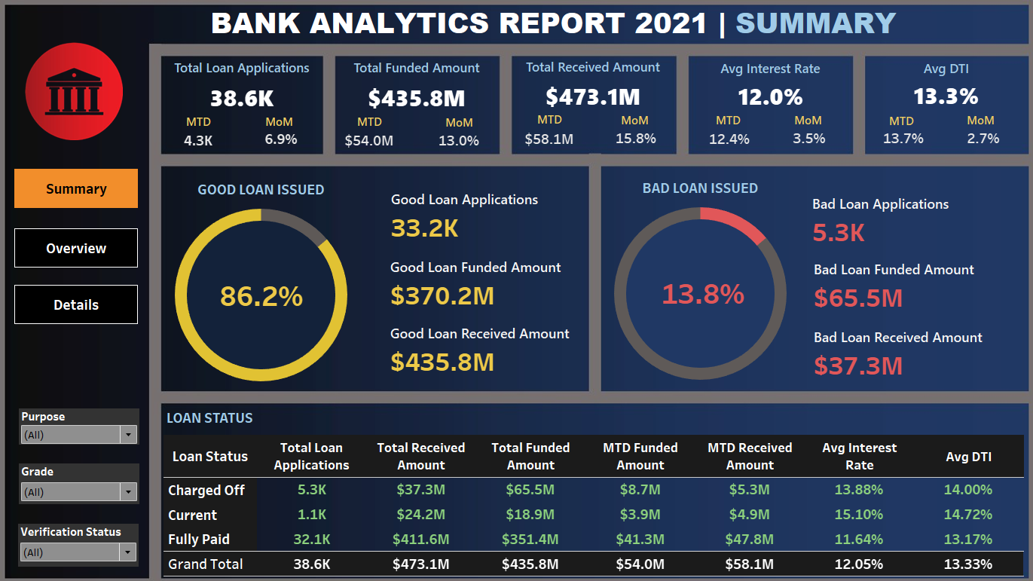
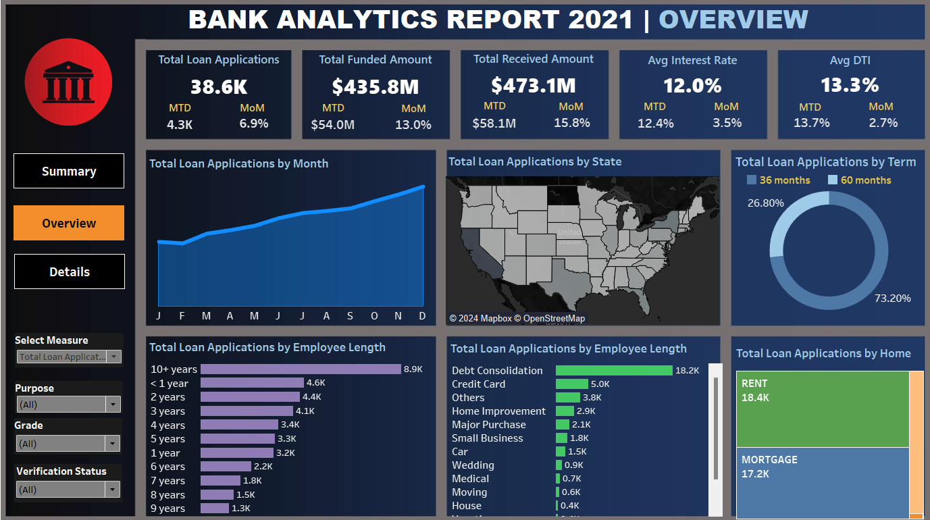
TABLEAU DASHBOARD

Slide 4
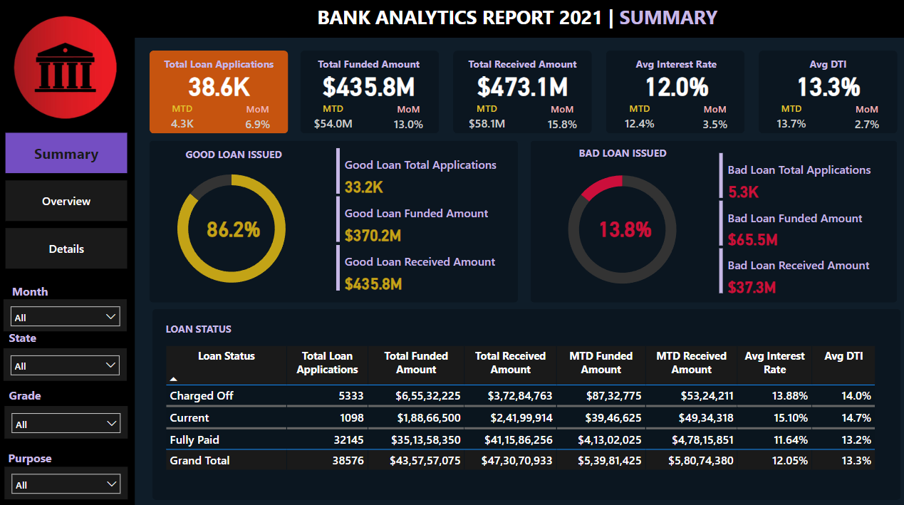
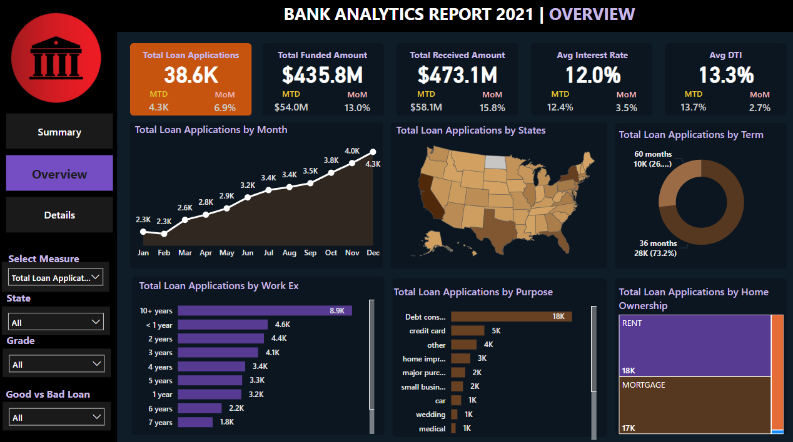
POWER BI DASHBOARD

Slide 5
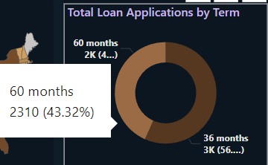
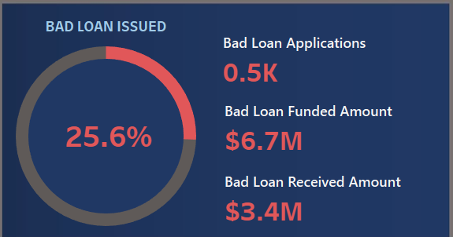
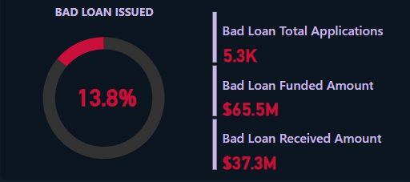
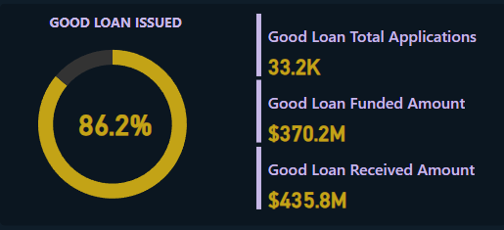
Analysis of Loan Portfolio Health: Good vs Bad Loans
Ideal Loan Portfolio:
Bad Loans (NPAs): Ideally, bad loans should constitute only 2% to 5% of the total loans. A higher percentage may indicate poor credit practices and potential financial instability.
Current Situation:
Bad Loans: Our current bad loan percentage stands at 13.8%, which is significantly higher than the ideal range. This is a concerning indicator of our current credit risk management.
Small Business Loans: Out of the 1.8K small business loan applications funded, 25.6% are currently trending as bad loans. This segment is the largest contributor to our bad loan portfolio. The bad loan rate here is almost double the overall average of 13.8%. The disproportionate level of bad loans within this segment highlights an urgent need for strategic intervention to mitigate risk and improve portfolio health.
Loan Term Analysis: Notably, bad loans are disproportionately higher in the 60-month term loans, representing 43% of the total loans, compared to the overall average of 27%. This suggests that our 60-month loan plans need urgent optimization.
60months Term Bad Loans
Small Business Bad Loans
Overall Good vs Bad Loans

Slide 6

Analysis of Loan Portfolio Health: Good vs Bad Loans
Proposed Solutions:
Risk-Based Loan Pricing: Introduce differentiated interest rates based on risk assessment for different loan categories. This can help balance risk in high-risk categories like small business and 60-month loans.
Tighten Credit Approval for Small Business Loans: Review the underwriting standards for small business loans, as they have the highest bad loan percentage. Implement stricter credit checks or require additional collateral/security to minimize risk.
Incentives for Timely Payments: Introduce rewards for borrowers who make timely payments.
Portfolio Diversification: Spread risk across various sectors to mitigate the impact of defaults.
Effective Collections for Current Bad Loans: Strengthen our collection strategies to recover overdue loans efficiently.
Flexible Repayment Plans: Introduce more flexible repayment options within the 60-month loan term to accommodate borrowers' varying financial situations, reducing the likelihood of defaults.
Enhanced Monitoring and Support: Implement regular monitoring of 60-month loans with early intervention programs to support borrowers at risk of default.

Slide 7
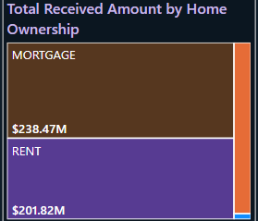
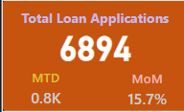
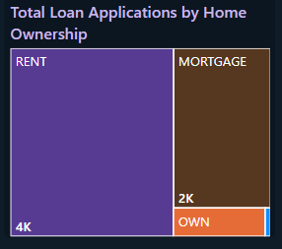
Home Ownership-wise Analysis
Nearly 90% of the loans are taken by individuals who have home as a mortgage or a rented house. We should target more towards such people and optimize loan planning.
State-wise Analysis
Key States for Analysis:
Top States: New York (NY), California (CA), and Florida (FL) are the most crucial states in our loan portfolio analysis.
Focus on California: California is particularly important, accounting for nearly 20% of all loan applications.
Insights from California:
Rented vs. Mortgage Properties: In California, loan applications from individuals with rented properties are nearly double those with mortgaged properties. This is a notable deviation from other states, where the number of loan applications from renters and mortgage holders is typically more balanced.
Strategic Implication: This trend suggests a unique market dynamic in California, indicating a potential opportunity to tailor loan products and marketing strategies specifically for renters in this state. We can have promotional offerings to rented home owners to increase the applications from mortgage home owners and we can increase the interest rates given to rented property holder as there is a huge demand of loans from them.
California >

Slide 8
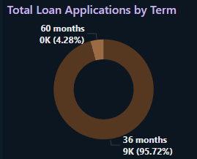
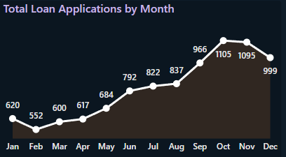
Grade-wise Analysis
Grade A Loans
Current Situation:
All the Grades are showing similar trends except Grade A which needs focus.
36-Month Term Preference: In Grade A, 96% of loan takers prefer a 36-month term plan, indicating a strong preference for shorter-term loans within this high-credit grade.
Q4 Application Trend: There is a noticeable decrease in loan applications from Grade A borrowers during Q4, suggesting a need for investigation into potential causes and solutions.
Proposed Solutions:
Promote 36-Month Loans: Launch targeted marketing campaigns and special offers to attract more Grade A borrowers to the 36-month term loans, boosting loan volumes in this preferred segment.
Q4 Promotions: Introduce time-limited incentives or discounts specifically for Grade A borrowers during Q4 to counteract the decline in applications and maintain a steady flow of loans.
Explore New Product Variations: Offer slightly varied loan terms with attractive rates or benefits to appeal to Grade A borrowers, encouraging those hesitant to apply.
Understand the Q4 Dip: Conduct a thorough analysis to understand the reasons behind the Q4 application decline. Use these insights to adjust product offerings and better align with borrower needs during this period.
Grade A Loans

Slide 9
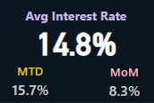
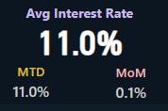
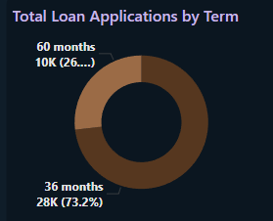
Term-wise Analysis
Current Situation:
Interest Rate Comparison:
60-Month Term Loans: Average interest rate is 14.8%.
36-Month Term Loans: Average interest rate is 11.0%.
Proposed Solutions:
Evaluate 60-Month Rates: Consider revising the interest rates for 60-month term loans to make them more competitive and attractive to borrowers as there are less number of applications from 60-Month term plans.
Highlight Lower Rates: Emphasize the lower interest rates of 36-month term loans in marketing efforts to encourage more borrowers to choose these terms.
Assess Profitability: Analyze the impact of interest rate adjustments on profitability and borrower attraction to optimize overall loan performance.
60 Months Term
36 Months Term

Slide 10
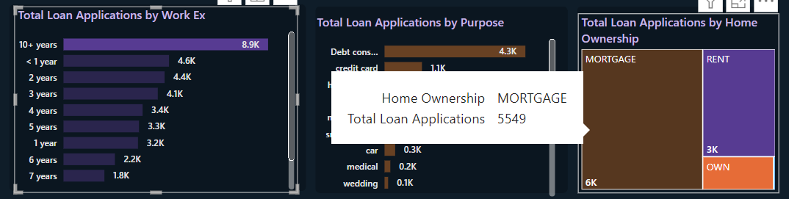
Work Exp-wise Analysis
Current Situation:
10+ Years Experience:
Stat: Nearly 50% (5.5K out of 8.9K) of individuals with 10+ years of experience have a mortgage house.
Insight: High correlation between extensive work experience and mortgage ownership.
6 and 7 Years Experience:
Stat: Proportion of mortgage holders is nearly equal to renters.
Insight: Balance between mortgage and rented properties in this experience bracket.
<1 Year to 5 Years Experience:
Stat: Renters outnumber mortgage holders by nearly 2:1.
Insight: Lower work experience is associated with a higher likelihood of renting.
Proposed Solution:
Targeted Ad Campaigns:
Focus ads on individuals with 10+ years of experience, highlighting mortgage-related products and services.
Tailor follow-up strategies to this group for mortgage offers or refinancing opportunities.
Similarly, customized approach below 5 years of experience individuals with promotional offers if they have a rented property.

Slide 11

FINAL SUGGESTIONS
Tighten Credit Approval for Small Business Loans: Review the underwriting standards for small business loans, as they have the highest bad loan percentage. Implement stricter credit checks or require additional collateral/security to minimize risk.
Increase Focus on Mortgage Loans: Promote mortgage loans aggressively due to their lower risk profile. Implement targeted marketing campaigns tailored to both homeowners and renters.
Target Renters in California: Develop specific loan products and incentives for renters, who represent a significant portion of loan applications in this state. This strategy aims to increase market share in California. In California, loan applications from individuals with rented properties are nearly double those with mortgaged properties, a notable deviation from other states.
Address Q4 Application Declines for Grade A Loans: Grade A Strategy: Investigate the decline in Grade A applications during Q4. Implement promotions or incentives during this period to maintain a steady flow of high-quality loan applications. There is a noticeable decrease in loan applications from Grade A borrowers during Q4, suggesting a need for investigation.
Leverage 36-Month Term Popularity for Grade A Loans: Since 96% of Grade A borrowers prefer 36-month terms, create new products or incentives that enhance the appeal of these loans, potentially increasing both volume and profitability.
Optimize Loan Plans in High-Risk Segments or Bad Loans: Focus on 60-Month Term Optimization: Address the high percentage of bad loans in 60-month plans by enhancing risk assessment and offering flexible repayment options to reduce defaults. Notably, bad loans are disproportionately higher in the 60-month term loans, representing 43% of the total loans, compared to the overall average of 27%. Additionally, enhancing monitoring and support for at-risk borrowers can help mitigate defaults. Finally, introducing incentives for timely payments will encourage responsible borrowing behavior and improve overall loan performance.
Diversify and Expand Credit Assessment Tools: Enhanced Credit Evaluation: Implement advanced credit assessment tools to better evaluate borrower risk across all grades, allowing for more confident loan approvals and reducing default likelihood. The average interest rate for 60-month term loans is 14.8%, while for 36-month term loans, it is 11.0%, suggesting an opportunity to revise rates for 60-month loans to make them more competitive.
This Photo by Unknown Author is licensed under CC BY-SA-NC

Slide 12
Thank You!
"In God we trust. All others must bring data."
- W. Edwards Deming

